Slide 1




Adding a Commodity
in
December 2025

Slide 2
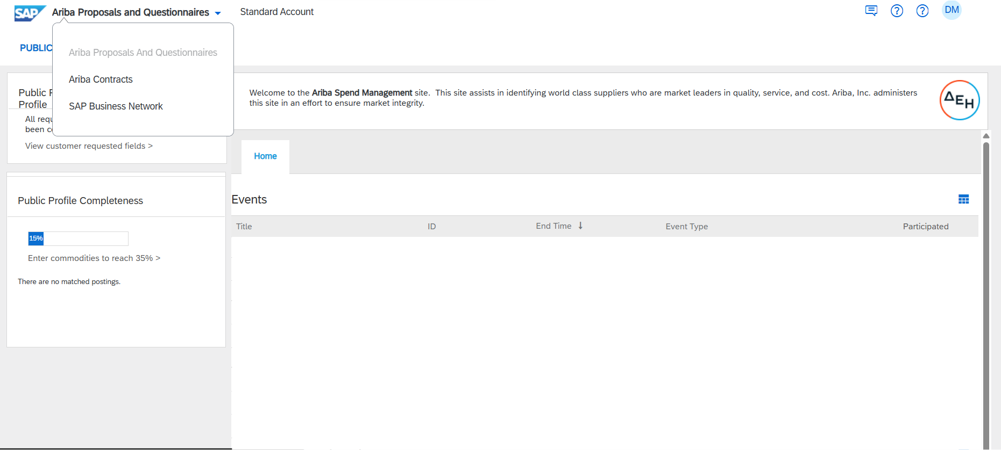

SAP Business Network Environment (accessed with the username and password you have for ARIBA)

Slide 3
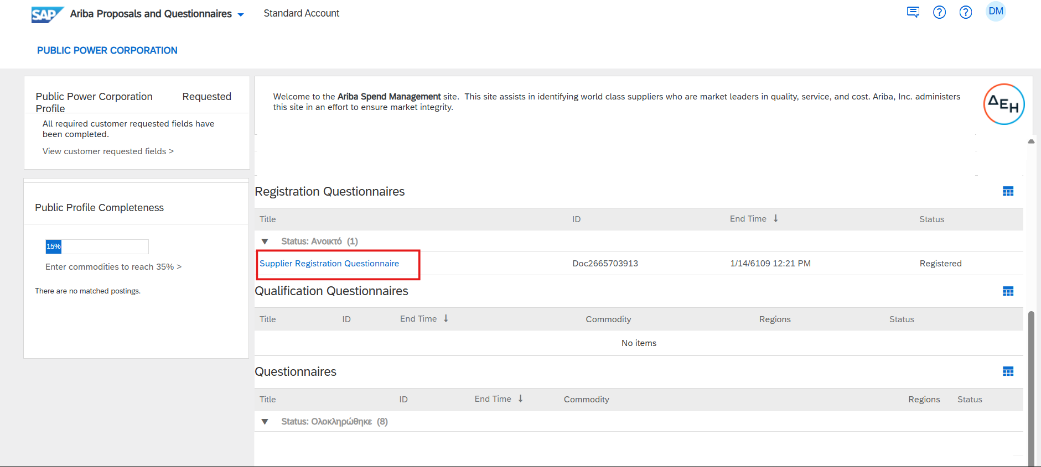
Enter Supplier Registration Questionnaire
Click on “Supplier Registration Questionnaire”

Slide 4
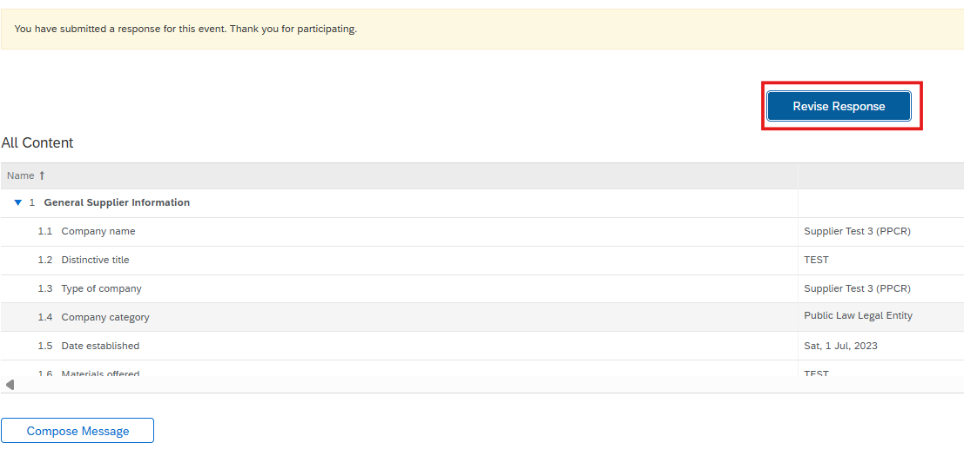
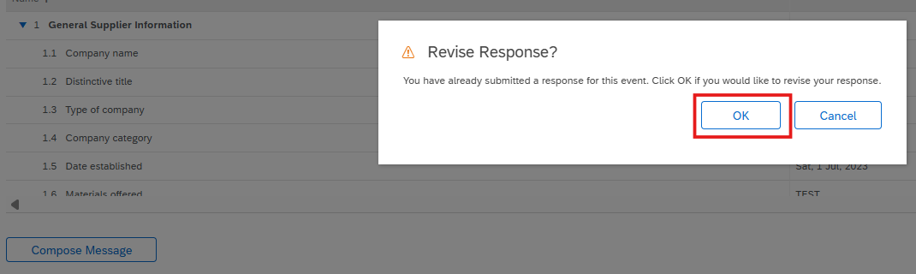
Revise Registration Questionnaire Response
Click on “Revise Response” button…
…and then “OK”

Slide 5

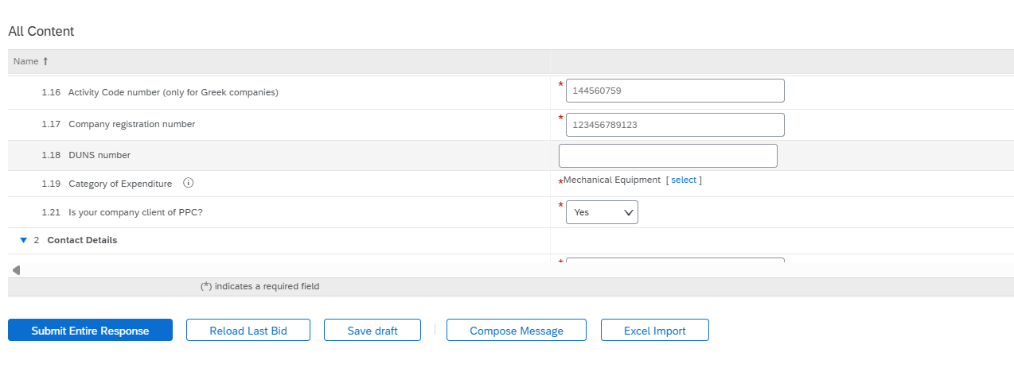
Commodity Change – Case Study
The existing expense category, as declared during the Supplier’s initial completion of the Registration Questionnaire, was:
ID: 3015 – MECHANICAL EQUIPMENT
Due to an expansion of activities, the Supplier wishes to add the category “MECHANICAL INSTALLATIONS” with ID: 8046.

Slide 6
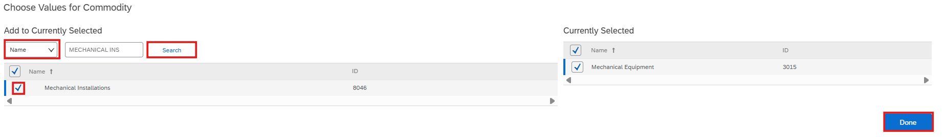
Adding a new Commodity using the category name
1
2
3
4
Actions
1
We choose “Name” in Search Filter
2
After typing in the category we want, we click on the "Search" button
3
Select the desired category by clicking the checkbox on the left
4
We complete the entry by clicking “Done"

Slide 7
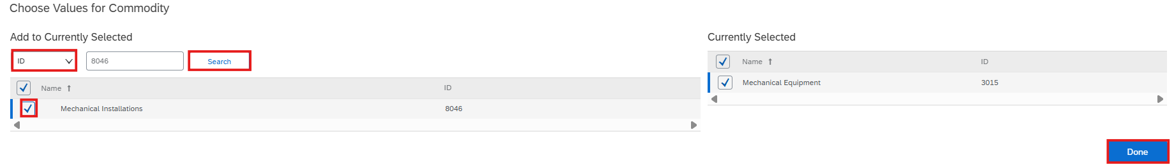
Adding a new Commodity using the category ID
1
2
3
4
Actions
1
We choose “ID” in Search Filter
2
After typing in the category we want, we click on the "Search" button
3
Select the desired category by clicking the checkbox on the left
4
We complete the entry by clicking “Done"

Slide 8
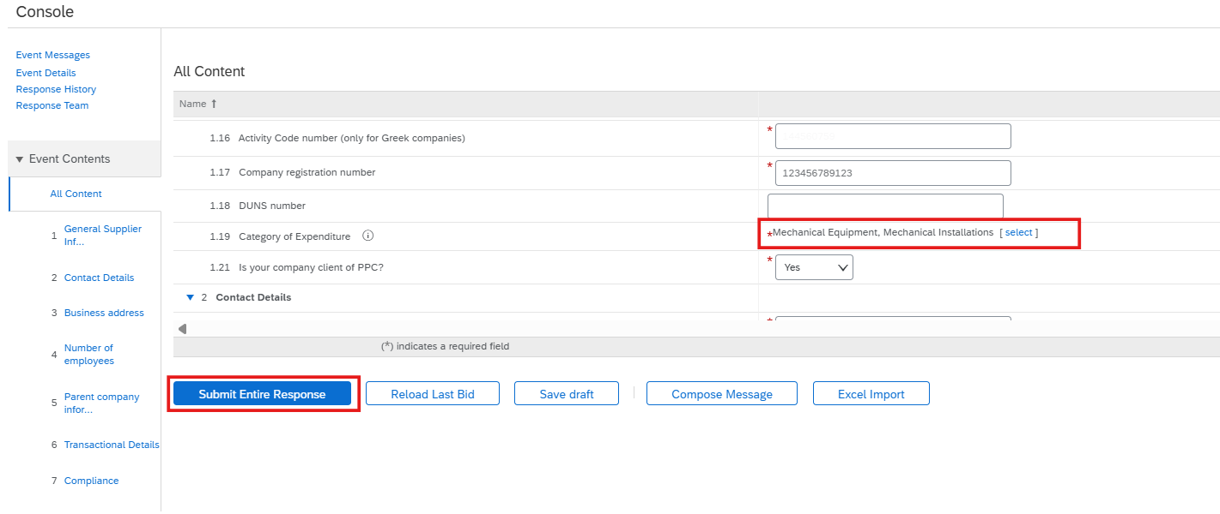
Submitting the updated categories to PPC SA
After verifying that the new entry was successfully created, click on ‘Submit Entire Response’. PPC ARIBA will automatically be updated. No more actions are required from your side.

Slide 9



